Slide 1
R1 อัธยา / อ.วิริยะ
8/01/2020

Slide 2
Anesthesia-Analgesia
December 2019 ● Volume 129 ● Number 6

Slide 3
BACKGROUND
IV sedation often used to relieve anxiety or stress during surgery (under regional anesthesia)
Dexmedetomidine is a sedative-analgesia agent
α₂ adrenergic receptor agonist
Analgesic effect has been established in various procedures
The influence of intraoperative dexmedetomidine sedation during regional anesthesia on postoperative pain and opioid consumption
Only limited number

Slide 4
BACKGROUND
The purpose of this study
To compare the postoperative analgesic effect of an intraoperative infusion of dexmedetomidine or propofol to provide sedation
Total knee arthroplasty (TKA)
Spinal anesthesia with multimodal postoperative analgesia regimen

Slide 5
BACKGROUND
Hypothesize
“Intraoperative sedation with dexmedetomidine would result in lower 24 and 48-hour postoperative opioid consumption than intraoperative sedation with propofol”

Slide 6
METHODS
Trial Design
A Randomized Trial
Register before enrollment at ClinicalTrials.gov
Approved by the institutional review board of Seoul National University Bundang Hospital
Informed consent from all participants.

Slide 7
METHODS
Patients: Adult patients undergo TKA under spinal anesthesia
Intervention: Dexmedetomidine infusion
Control: Propofol infusion
Outcome
1. Primary outcome
The cumulative amounts of fentanyl administered via IV PCA at 24 and 48 hours postoperatively
2. Secondary outcome
Postoperative NRS at 6, 12, 24 , and 48 hours
Postoperative use of rescue analgesia and antiemetic drugs

Slide 8
METHODS
Participants
Inclusion criteria
Patients scheduled to undergo TKA
Age range 20-80 years
Planned use of regional anesthesia
American Society of Anesthesiologists Physical Status I or II
(ASA I or II)

Slide 9
METHODS
Participants
Exclusion criteria
Refuse to participate
Contraindication to spinal anesthesia
Refusal
Preexisting hematological disease
Recent medications that may interfere with hemostasis (antiplatelet/anticoagulant)
History of hypersensitivity to propofol, dexmedetomidine, or local anesthetics
Cardiovascular disease
Inability to comprehend the numerical rating scale (NRS)
Inability to use an IV patient-controlled analgesia (IV PCA) device

Slide 10
METHODS
Participants
Dexmedetomidine
Propofol
Block randomization parallel 1:1
web-based randomization system (http://www.randomization.com)
Notes:
gggg

Slide 11
METHODS
A blinded investigator, who was not directly involved in the anesthetic care → collect all postoperative data
Patients and orthopedic surgery team were blinded to group allocation
Anesthesiologist who attended to the patients knew the group allocation (different in color and infusion method)

Slide 12
Outcome variables
Primary outcome
- The cumulative amount of fentanyl via IV PCA at 24, 48 hours
Secondary outcome
- Post operative resting pain scores (NRS: 0 = no pain and 10 = the most severe pain imaginable) at 6, 12, 24, and 48 hours
- Pain burden calculated using trapezoidal method
The amount of rescue analgesics and antiemetics
PACU stay time
Patient satisfaction (0 = very unsatisfied, 100 = completely satisfied)
The SBP and HR (initiation of sedation until PACU discharge)

Slide 13
Sample size
Kim et al; reported the cumulative dose of fentanyl during the 24 hours after TKA was 229 ± 175 mcg
Same pain control protocol
Reduction of the amount of fentanyl by 50% or more
24 patients required per group
Power of 80% , P value < 0.05
Finally, select 27 patients per group, anticipating a 10% dropout rate

Slide 14
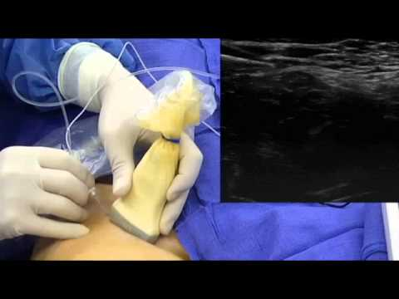
Femoral Nerve Block, Spinal Anesthesia, Surgery, and Intraoperative Sedation
Femoral Nerve Block
Ultrasound-guided femoral nerve block on the
ipsilateral inguinal area before SA
In-plane technique and confirm accurate
needle tip position via hydrodissection
10 ml of 0.2% ropivacaine via catheter
Confirm the decrement of cold sensation in the anterior thigh 10-20 minutes later
After surgery, the patency and effectiveness were assess at 24 and 48 hour.

Slide 15
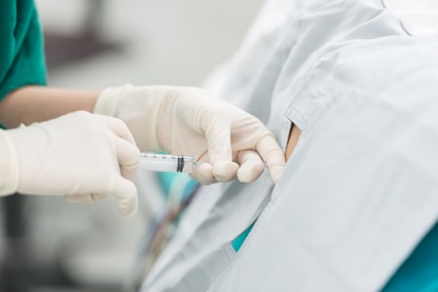
Femoral Nerve Block, Spinal Anesthesia, Surgery, and Intraoperative Sedation
Spinal Anesthesia
25-gauge Quincke needle
L3-L4 or L4-L5 by using middle or paramedian approach
2.0-3.0 mL of 0.5% hyperbaric bupivacaine with 15-20 mcg of fentanyl
assess sensory blockade using the cold sensation test at 5-minute intervals for up to 30-minutes

Slide 16
Femoral Nerve Block, Spinal Anesthesia, Surgery, and Intraoperative Sedation
Surgery
1 experienced orthopedic surgeon (blind to the study protocol)
same surgical technique and prosthesis type in all patients
Rehabilitation with the standard protocol
Walking with crutches or a walker at 48 hours after surgery
Active and passive ROM exercises at 72 hours after surgery

Slide 17
Femoral Nerve Block, Spinal Anesthesia, Surgery, and Intraoperative Sedation
Intraoperative sedation
Sedative drug prepared by an anesthesiologist who was not involved in the study
Provide to patient after confirming the proper regional anesthesia and obtaining hemodynamic stability
Propofol: Target-controlled infusion device (TCI)
- effect site concentration maintain a range of 0.5-2.0 mcg/ml
Dexmedetomidine: diluted with 0.9% saline at 4 mcg/ml
Loading dose: 1 mcg/kg over 10 minutes
Continuous dose: 0.1-0.5 mcg/kg/hour

Slide 18
Femoral Nerve Block, Spinal Anesthesia, Surgery, and Intraoperative Sedation
Intraoperative sedation
Level of modified observer’s assessment of alertness/sedation score of 3 or 4
Standard sedation depth at their institution
Evaluate the sedative levels every 15 minutes
Discontinue
- Propofol: final surgical dressing
- Dexmedetomidine: subcutaneous and skin suturing was started (about 40 minutes earlier than the discontinuation of propofol)

Slide 19
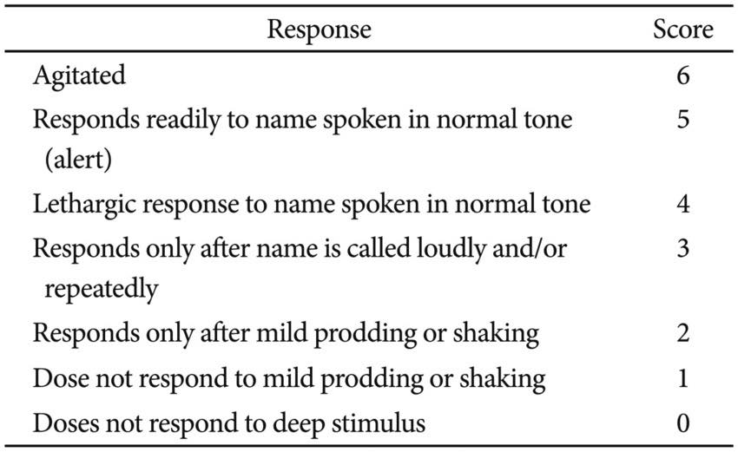
Modified observer’s assessment of alertness/sedation

Slide 20
Pain Management Protocol
Multimodal analgesia technique
Preemptive analgesic medication
pregabalin 75 mg p.o.
celecoxib 200 mg p.o.
acetaminophen 650 mg p.o.
dexamethasone 10 mg IV 40 minutes before surgery
2. Intraoperative periarticular injection at the end of surgery
mixture of 300 mg of ropivacaine, 10 mg of morphine, 30 mg of ketorolac, 300 mcg of 1:1000 epinephrine, and 750 mg of cefuroxime

Slide 21
Pain Management Protocol
3. Postoperative continuous femoral nerve block
0.2% ropivacaine 5 ml/h for 48 hours
4. IV PCA for 72 hours
no basal infusion
bolus 1 ml (20 mcg for patients <60 years
15 mcg for patient 60-80 years)
lockout time of 10 minutes
5. Regular oral analgesia including;
650 mg of oral acetaminophen
200 mg of celecoxib
75 mg of pregabalin q 12 hours
6. 100 mg IV ketoprofen for breakthrough pain as needed for NRS>4

Slide 22
Pain Management Protocol
Prevent postoperative nausea and vomiting
0.3 mg of IV ramosetron was routinely administered
Rescue antiemetics (10 mg of IV metoclopramide)

Slide 23
Statistical Analysis
The data express as the mean ± SD
A Student t test or a Mann-Whitney U test : compare continuous variables between groups
X² test or Fisher exact test : category data between groups
Friedman test : repeat measurements (NRS score)
Kruskal-Wallis test : explore potential differences between groups

Slide 24
Statistical Analysis
Criterion for rejection null hypothesis (CIs 99.98%)
Primary outcome : P < 0.17
NRS score P < 0.01
Pain burden P < 0.025
IBM SPSS Statistics Version22 were used for all analyses

Slide 25
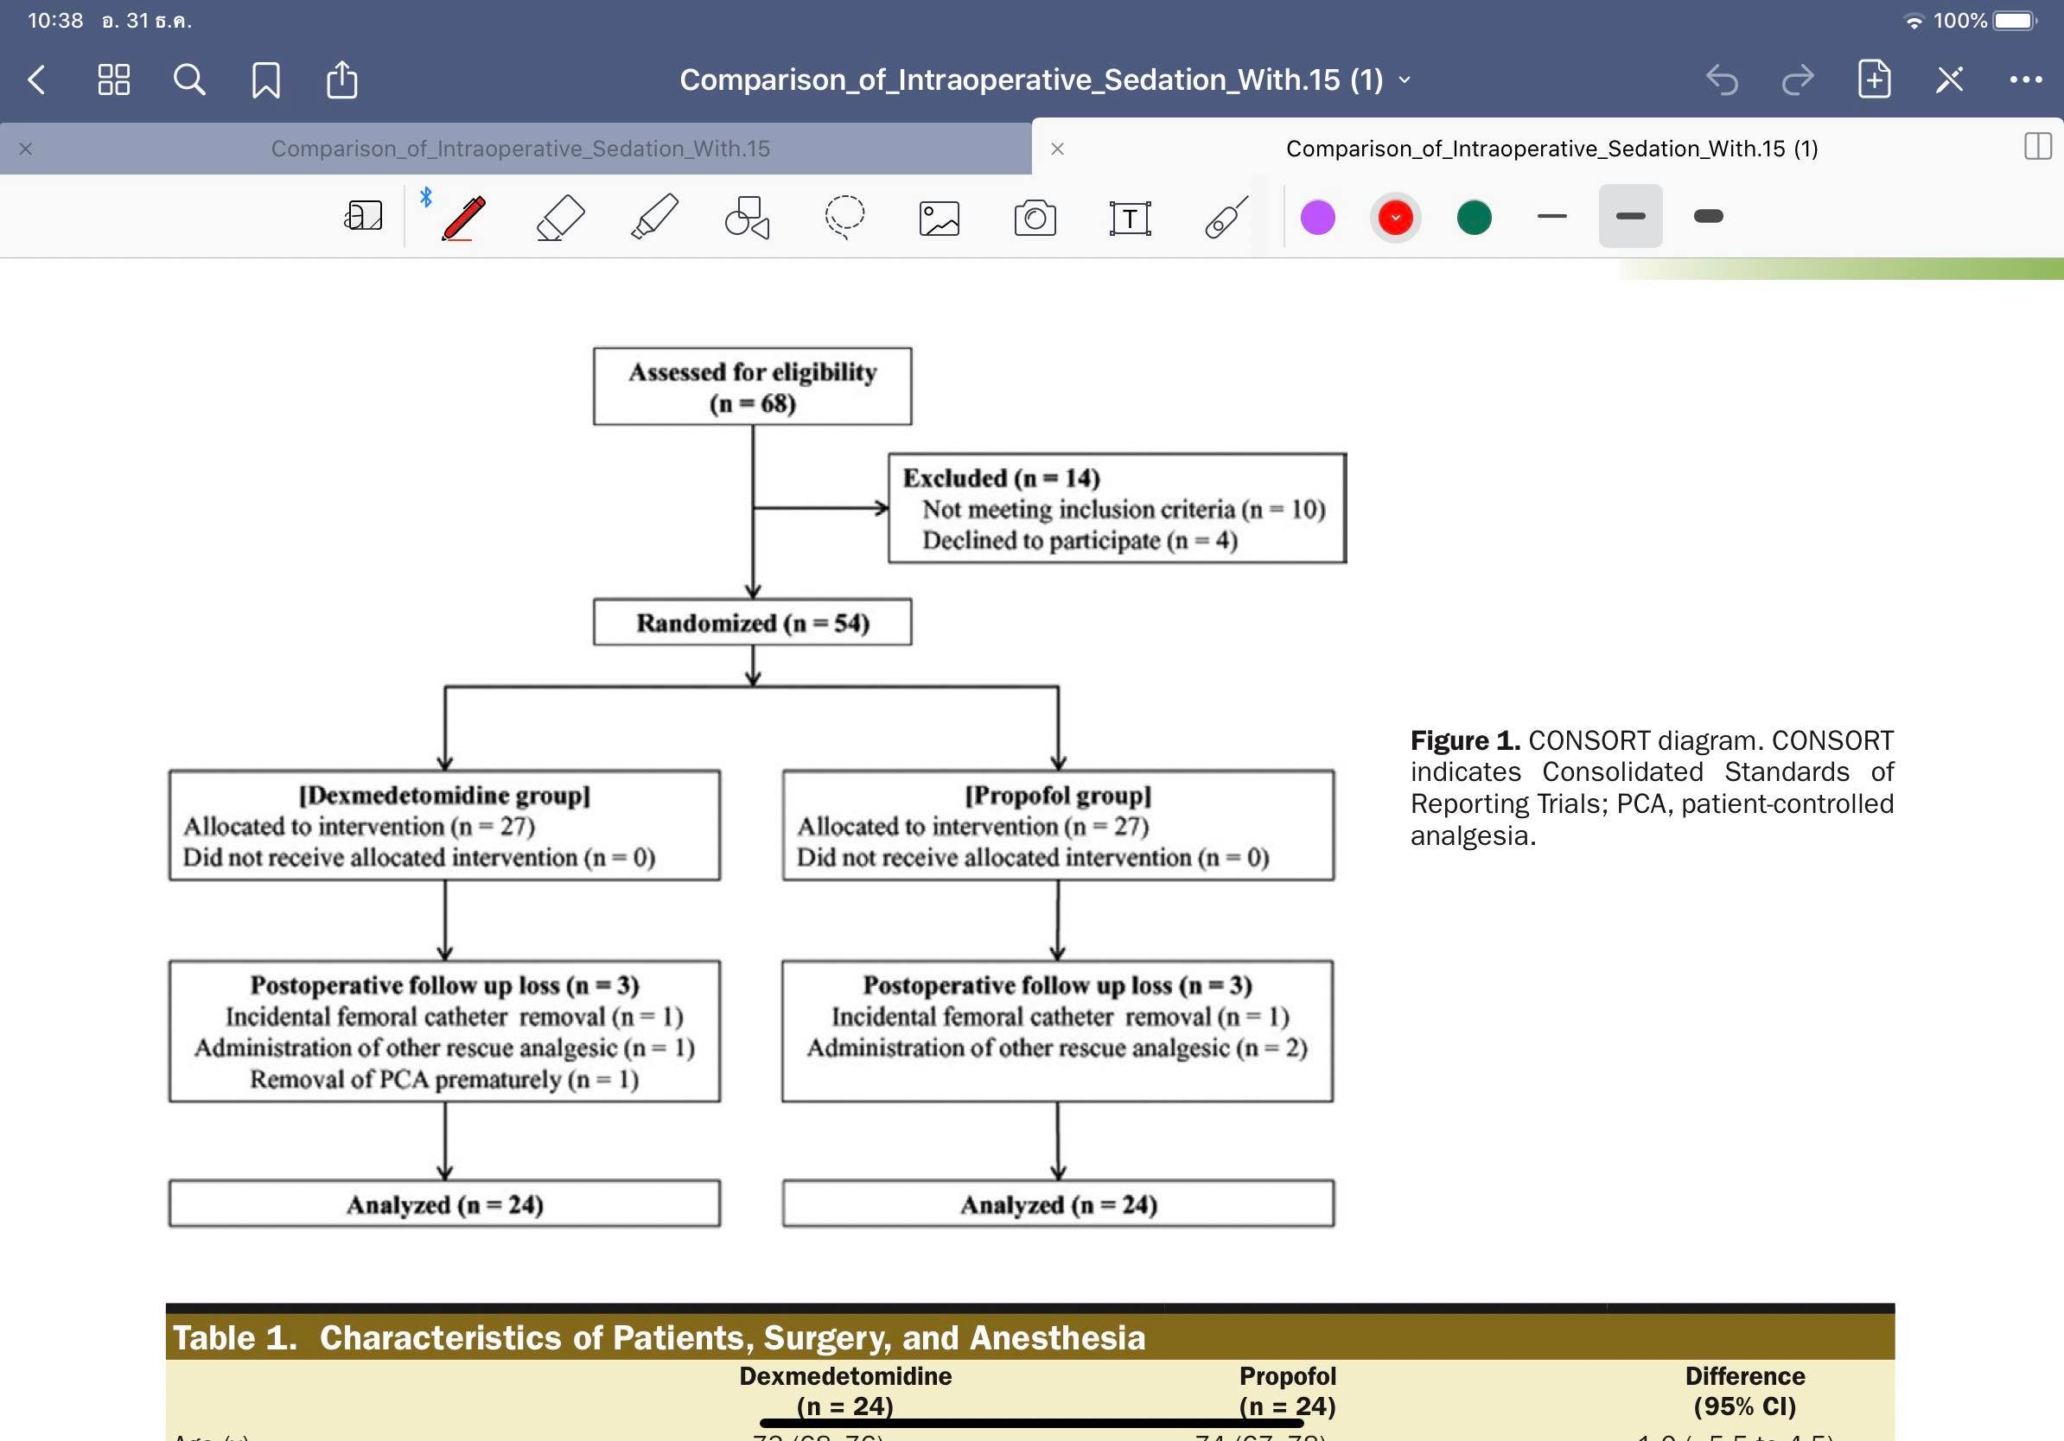
Results
Between May and August 2016

Slide 26
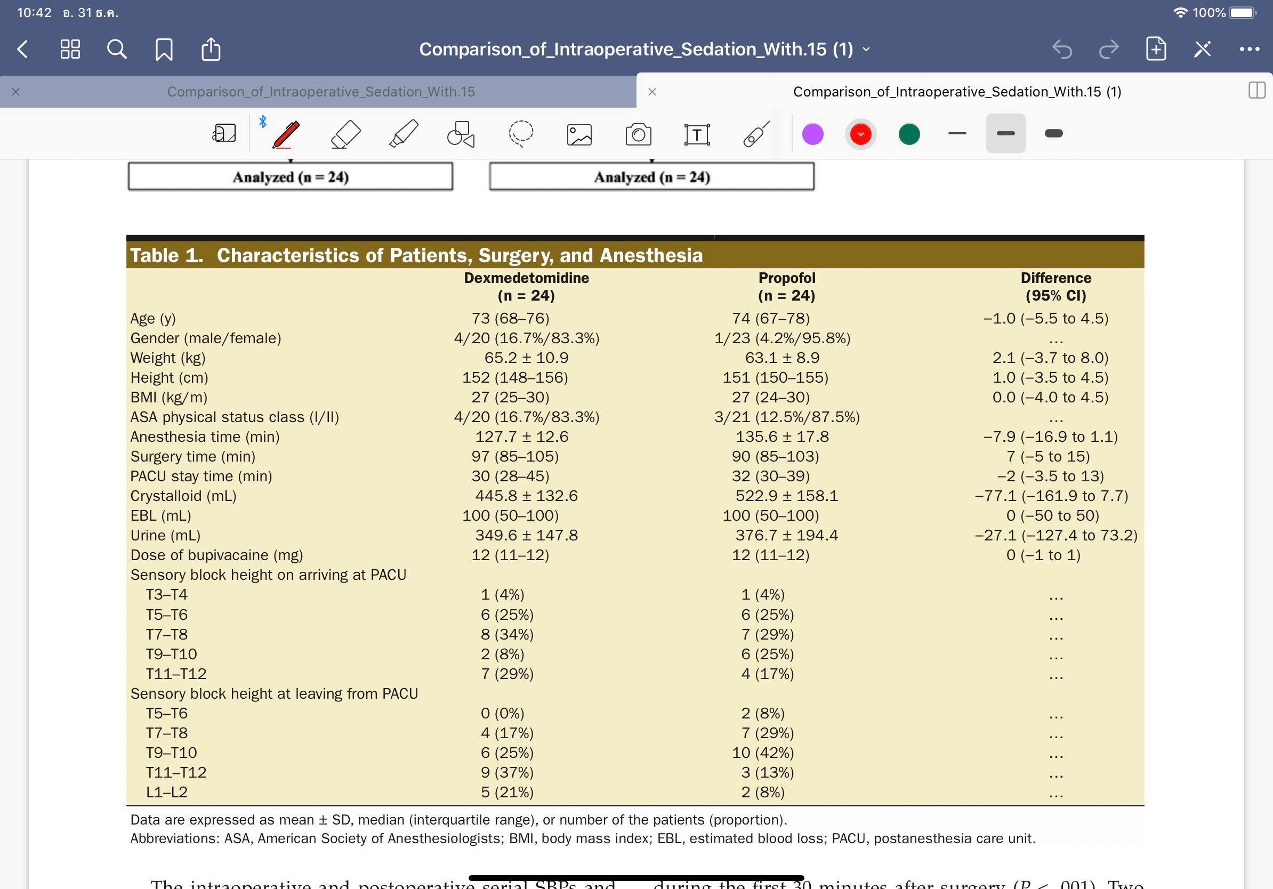
Results
No difference was observed

Slide 27
Results

Slide 28
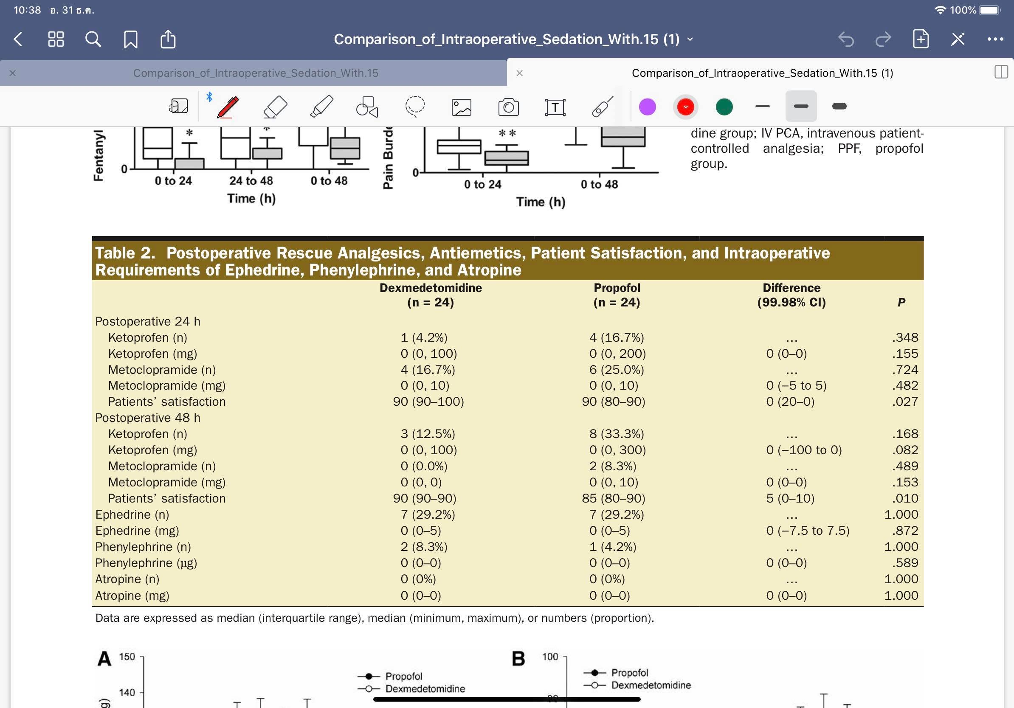
Results

Slide 29
Results

Slide 30
Discussion
The results confirmed the hypothesis
Intraoperative dexmedetomidine reduced postoperative consumption of fentanyl without serious perioperative hemodynamic changes
Postoperative NRS pain scores and pain burden values lower in dexmedetomidine group
Statistic significant, the clinical relevance is likely low
Adequate analgesia, satisfaction score were high in both groups

Slide 31
Discussion
Analgesic adjuvant property of dexmedetomidine!?
Ge et al: Dexmedetomidine the analgesic properties in patients undergoing general anesthesia
Dexmedetomidine did not reduce the post operative opioid consumption in pediatric patient undergoing tonsillectomy
The half-life of dexmedetomidine is around 2 hours
How dexmedetomidine can impact pain score 48 hours after administration?

Slide 32
Discussion
Long-term analgesic effect remains unclear
Ge et al: difference action pathways
- Hypnotic : ascending noradrenergic pathway in the locus ceruleus
- Analgesia : α₂ adrenergic receptor-dependent descending pathway in the spinal cord
One explanation : preventive analgesia may prolong the duration of analgesic drug

Slide 33
Discussion
Considerations
Dexmedetomidine: bradycardia and hypotension (did not increase requirement of any chronotropic drugs)
Prolong recovery time from sedation after dexmedetomidine infusion
Discontinue approximately 40 min earlier than discontinue propofol
All patients recovered properly and discharged from PACU without any delay

Slide 34
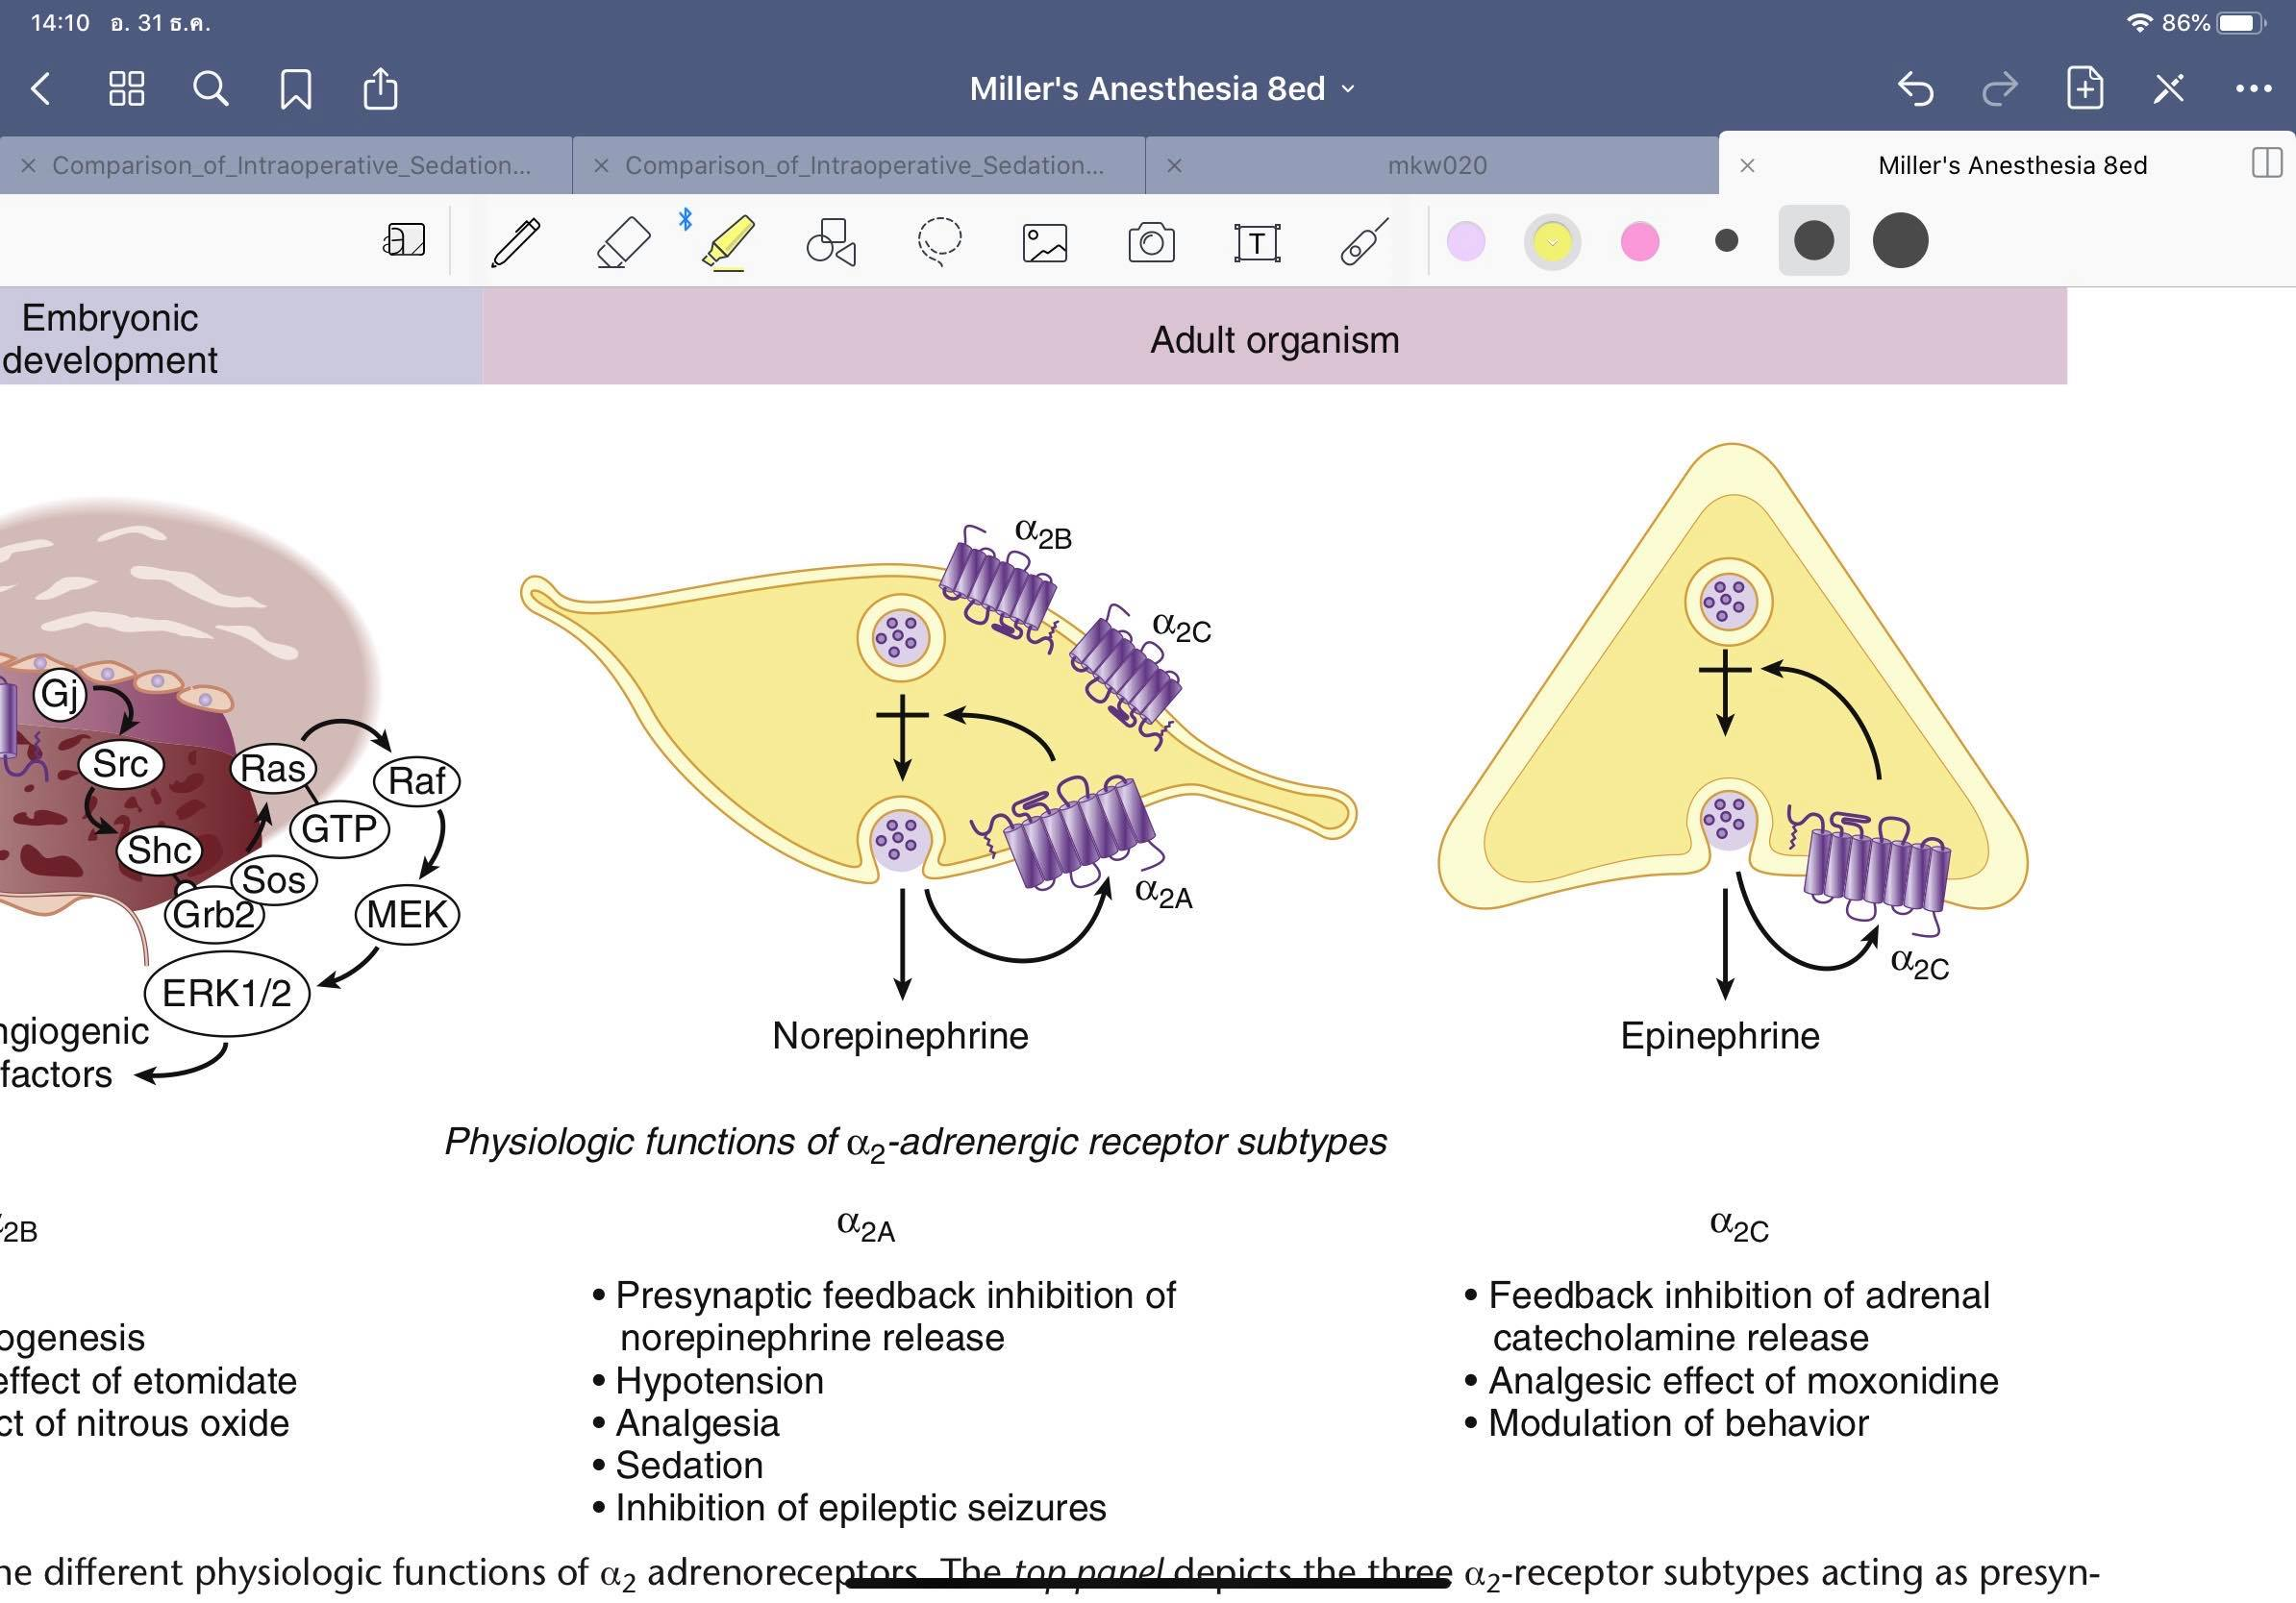
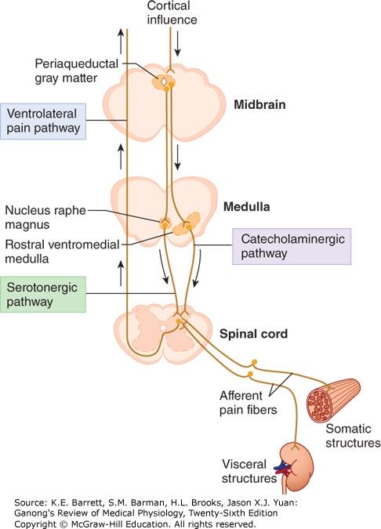
Alpha2 agonist

Slide 35
Limitations
They did not assess sedation levels in the PACU
- May have more sedated and used less fentanyl
They only measure pain scores at rest
Multimodal analgesia protocol
Sample size
- The SD did not decrease by 50%
- may have been to small to adequately explore hypothesis
- 80% power to detect a 50% decrease in fentanyl consumption

Slide 36
Conclusion
Intraoperative administration of dexmedetomidine
reduced fentanyl consumption
Intraoperative dexmedetomidine may be a useful
adjunct in multimodal analgesia protocol for patients
undergoing TKA with a spinal anesthetic

Slide 37
Critical Appraisal : RCT
Does this study address a clear question?

Slide 38
Critical Appraisal : RCT
Are the results of this single trial valid?

Slide 39
Critical Appraisal : RCT
Are the results of this single trial valid?

Slide 40
Critical Appraisal : RCT
What were the results?
?
YES

Slide 41
Critical Appraisal : RCT
Can I apply these valid, important results to my patients?

Slide 42
Thank you

